Slide 1
Daily Life in Roman Empire

Slide 2
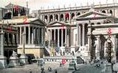
What was daily life like in Ancient Rome?
Daily Life
Law and Order
Religion
Family Life
Food and Drink
Housing
Education
Recreation
Country Life

Slide 3
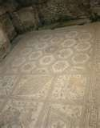
Daily Life in Ancient Rome
A city of contrasts
Palaces and crammed apartments.
City Markets where men and women shopped.

Slide 4
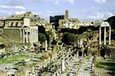
Daily Life in Ancient Rome
Rich only a small part of Rome’s population.
Poor lived in filthy neighborhoods.
Children of the poor were lucky to live past 10.

Slide 5
Law and Order
Romans believed in the rule of law.
Roman law was strict, but crime was common.
Rich men tried to hide their wealth.
Not all law was applied equally.

Slide 6
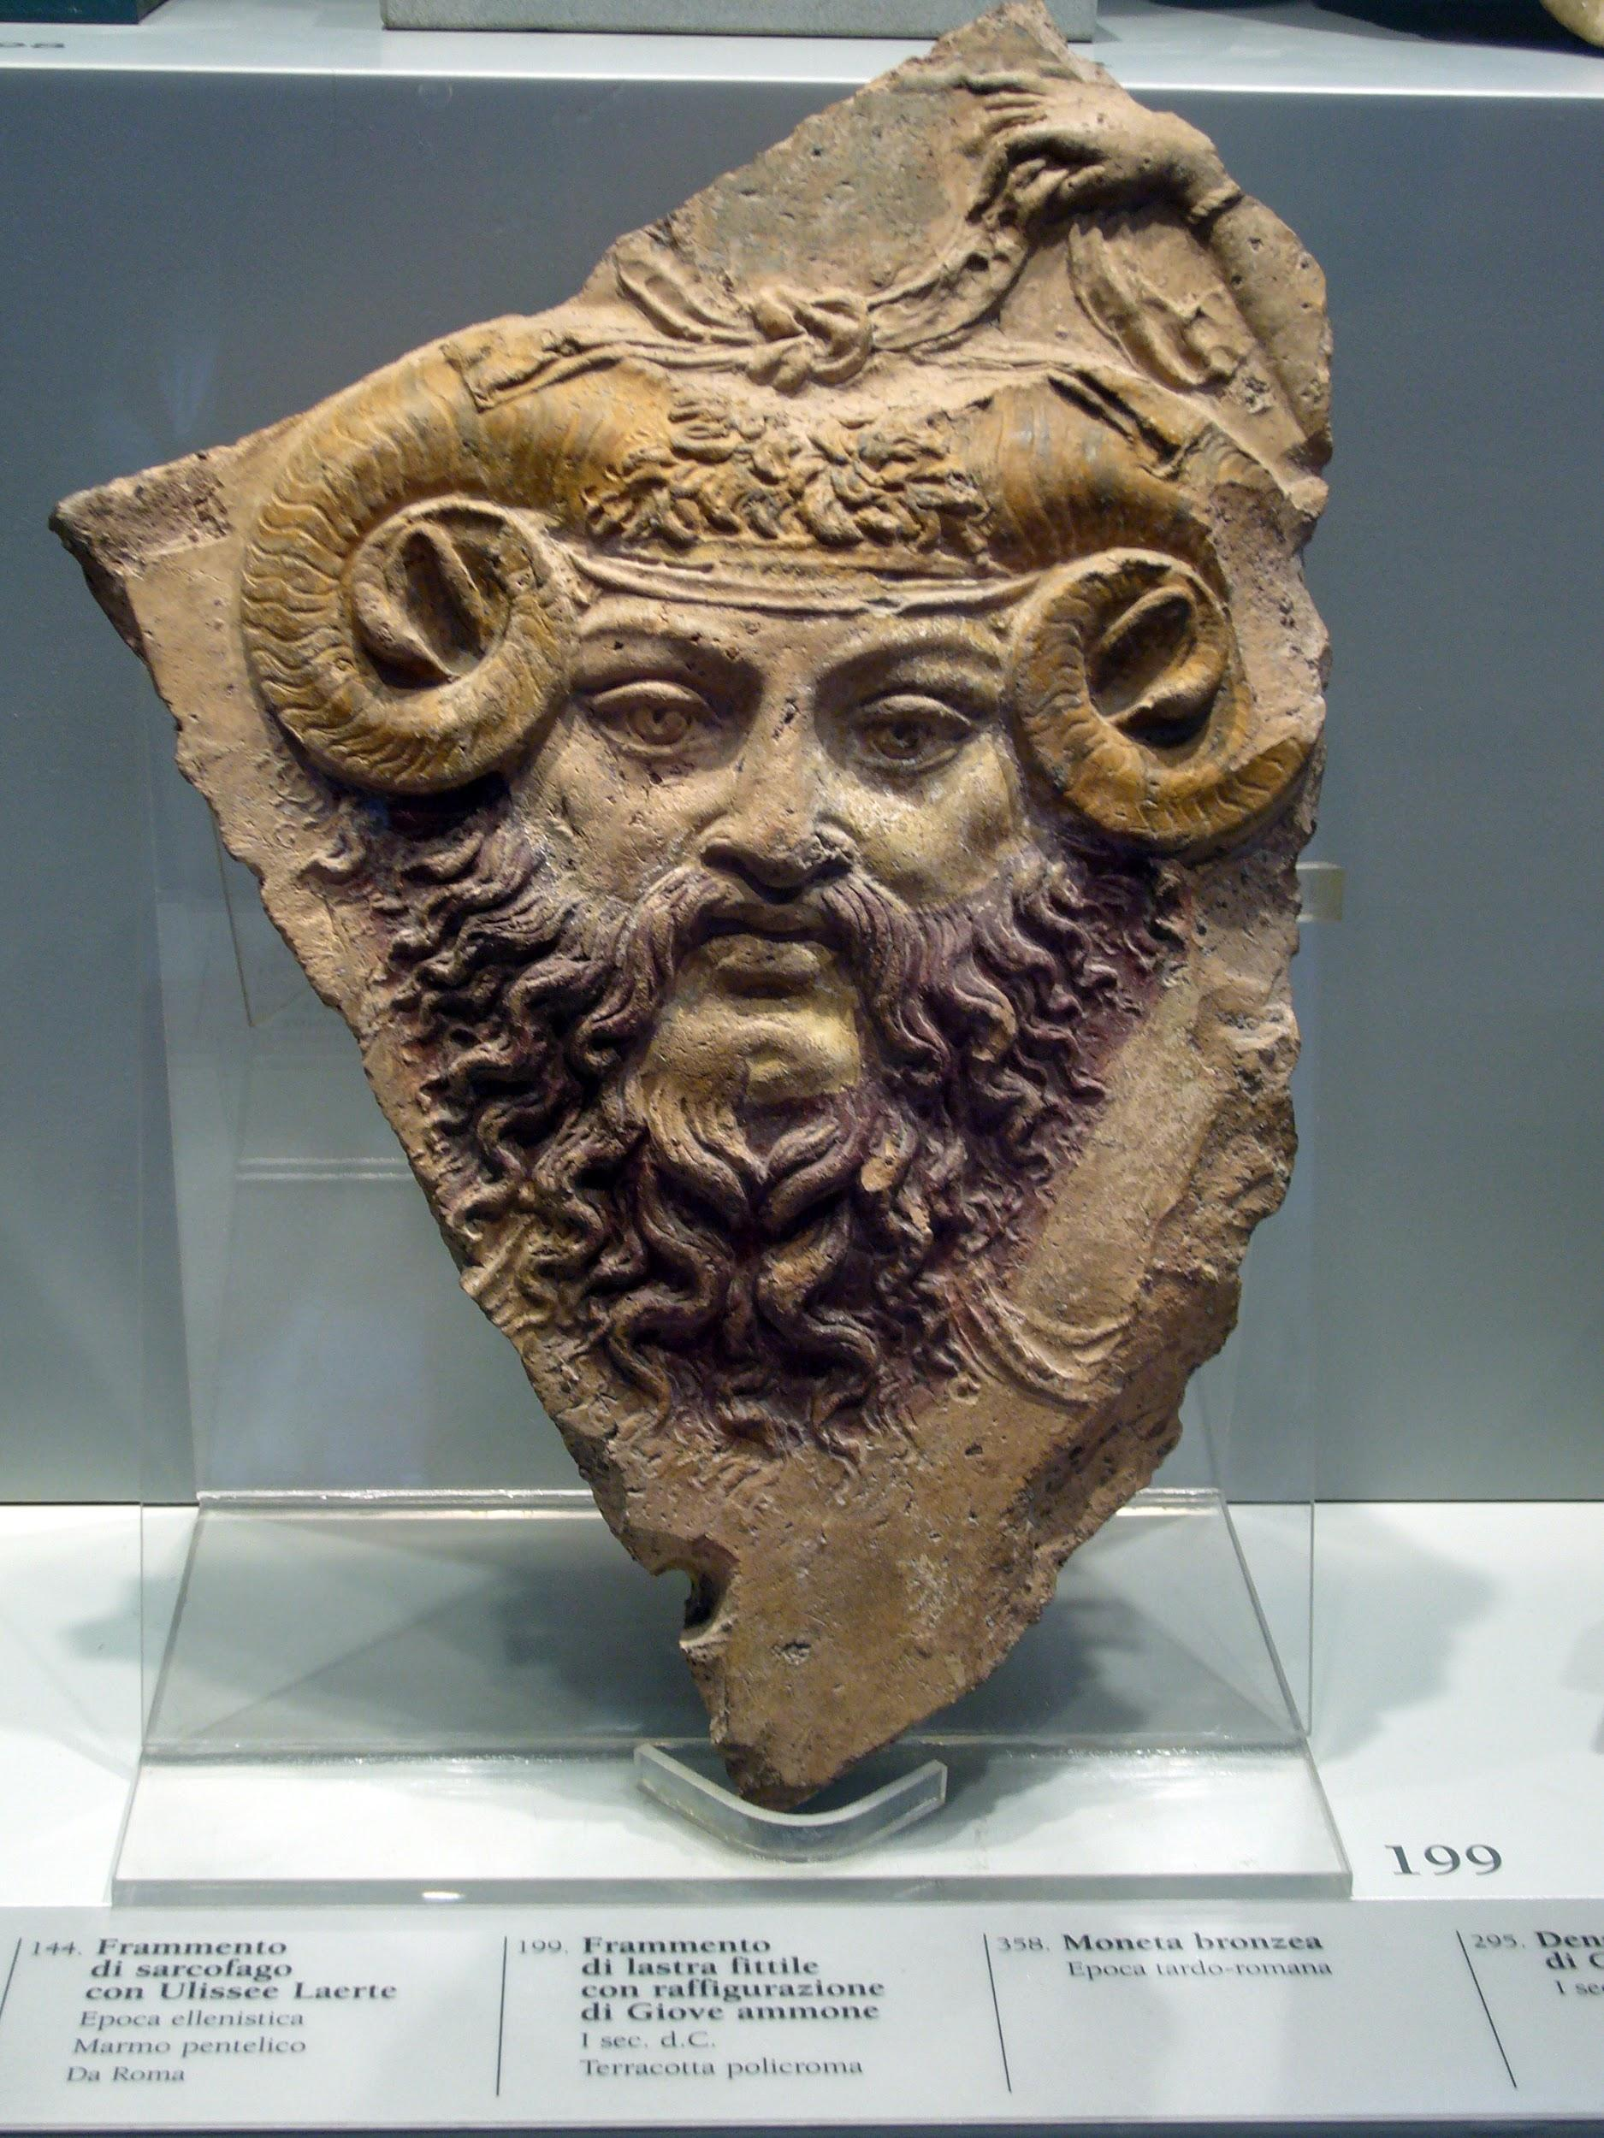
Religion
Religion was important to Romans.
Romans wanted to please their gods.
Believed gods controlled their daily life.
If someone was sick, Romans would leave an offering.
Festivals and holidays held throughout the year.

Slide 7
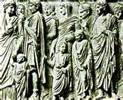
Family Life
The family was ruled by the father.
Roman men provided for the family.
In rich families men worked.
In poor families both men and women worked.

Slide 8
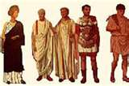
Family Life
Babies were born at home.
They were named in a ceremony after 9 days.
Roman boys had a ceremony between ages 14-18.
Roman girls had no ceremony and were married between 12-18.

Slide 9
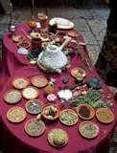
Food and Drink
What Romans ate depended on whether they were rich or poor.
Main foods were bread, beans, spices, vegetables, cheese and meats.

Slide 10
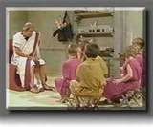
Education
Poor children were sent to work instead of school.
Wealthy children were tutored until seven and then went to school.

Slide 11
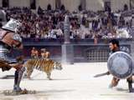
Recreation
Roman emperors gave the poor bread and circuses.
This included gladiator games and chariot races.

Slide 12
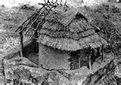
Country LIfe
90% of the people lived in the country.
Wealthy Romans owned Villas.
Many country folks were not slaves but their lives were hard.
They lived in huts and worked trying to earn enough to survive.

Slide 13
Assignment
Step 1: Create a Venn Diagram to compare/contrast the lives of Rich vs. Poor Roman citizens.
Step 2: Using this information, create a diary entry of what your life is like as either a wealthy Roman or a poor Roman. Must be at least 5 sentences.
Step 3: Create a second diary entry as a citizen from the opposite class that you chose in Step 2.

